Slide 1
Learning to Rank v2.0
LexisNexis Legal Search Guild
What it is, how it’s done, and what it can do for you
Sujit Pal, Elsevier Labs
October 11, 2018

Slide 2
Outline
History
Overview
Practical Considerations
Case Studies
Wrap Up

Slide 3
History
1992: Idea of LTR (or Machine Learned Ranking) first proposed
2003: Altavista (later acquired by Yahoo!) using LTR in its engine
2005: Microsoft invents RankNet, deploys in Bing
2008: In contrast, Google’s engine hand tuned, relies on up ~200 signals
2009: Yandex invents and deploys MatrixNet in its engine
2016: Google says RankBrain is #3 signal to its search engine
2016: Bloomberg contributes LTR plugin to Solr
2017: Open Source Connections contributes LTR plugin in Elasticsearch
Notes:
Most of the key work done between 2008 – 2011, competitions sponsored by MS, Yahoo and Yandex.
Bloomberg LTR meetup – Michael Nillson, Erick Erickson.
OSC LTR – at Haystack earlier this year.

Slide 4
Overview

Slide 5
LTR Pipeline
Training: Build LTR model using training data (query, document, label) triples
Label is rank
Inference: Use model to predict label ŷ = h(x) from unseen (query, document) pairs
Image Credit: https://towardsdatascience.com/when-to-use-a-machine-learned-vs-score-based-search-ranker-aa8762cd9aa9

Slide 6
LTR used as re-ranker
Query
LTR models are usually more computationally expensive than search engines.
Search engine used to pull out matched documents
Top-N of these documents are fed into the LTR model and top-n of those are replaced with the output of the model, for N >> n (typically 50-100x).
Index
Matched (10k)
Top 1000
retrieved
Scored
(10k)
Ranking Model
Re-ranked
Top 10
Image Credit: https://lucidworks.com/2016/08/17/learning-to-rank-solr/

Slide 7
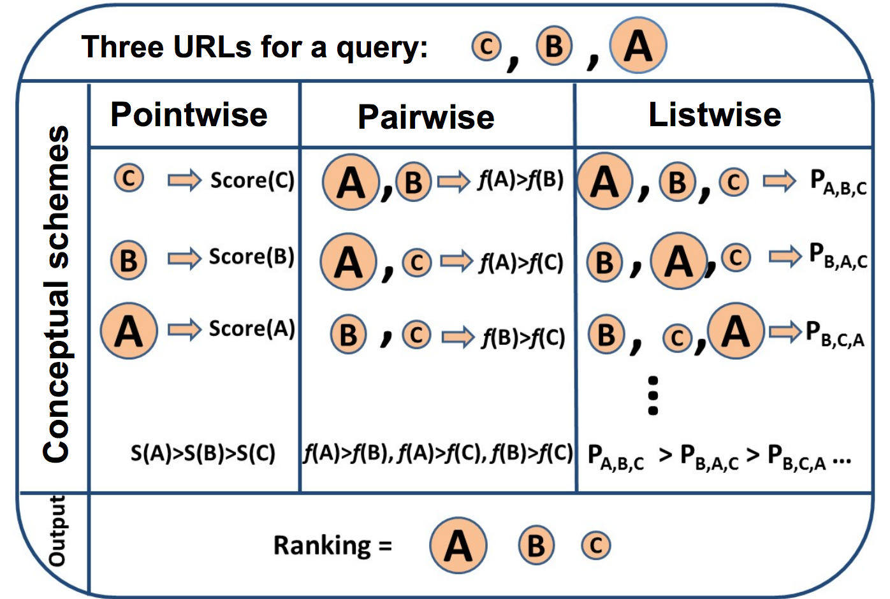
Types of LTR Algorithms
Pointwise – documents ranked by relevance of each (query, document) pair
Pairwise – documents ranked by considering priority between pairs of (query, document) pairs
Listwise – documents ranked by considering the entire relevance ordering of all (query, Documents) tuples per query
Image Credit: https://www.hiit.fi/wp-content/uploads/2018/04/Learning-to-Rank-S11.pdf

Slide 8
Popular LTR Libraries
RankLib (Java) – from Lemur Project (UMass, CMU), provides Coordinate Ascent, Random Forest (pointwise), MART, RankNet, RankBoost (pairwise), LambdaMART (pair/listwise), AdaRank and ListNet (listwise)
SVMRank (C++) – from Cornell, provides SVMRank (pairwise)
XGBoost (Python/C++) – LambdaRank (pairwise)
PyLTR (Python) – LambdaMART (pairwise)
Michael Alcorn (Python) – RankNet and LambdaMART (pairwise)

Slide 9
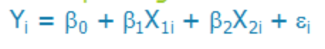
Common Algorithms
Linear Model
Predicted rank is linear combination of input features
RankNet
Neural network based
Good for binary (relevant/irrelevant) labels
Weight matrix transforms input features into rank probabilities
LambdaMART
Tree (forest) based
Good for multi-class labels
Feature splits with thresholds
Image Credits: https://slideplayer.com/slide/9347431/, https://dimensionless.in/introduction-to-random-forest/

Slide 10
Practical Considerations

Slide 11
Reasons to consider LTR
Too many parameters to tune manually without overfitting to particular query set.
Availability of enough (implicit or explicit) good training data to train LTR model.

Slide 12
Acquiring labels
Implicit
Intrinsic features (words, phrases)
Document metadata
User Clicks
Time spent on document
Purchases (if applicable)
Cheap to build but noisy
Explicit
Human expert rates relevancy of each document against query
Cleaner but expensive to build
Image Credit: https://www.datasciencecentral.com/profiles/blogs/handling-imbalanced-data-sets-in-supervised-learning-using-family

Slide 13
Traditional Ranking Models
Vector Space Models
Boolean – predicts if document relevant to query or not
TF-IDF – rank documents by cosine similarity between document and query
Probabilistic Models
BM25 – rank documents by log odds of relevance to query
LMIR – probability of document’s LM generating terms in query
Importance based Models
HITS – rank documents by hubness/authority (inlinks/outlinks).
PageRank – rank document by probability of random surfer arriving on page
Impact Factor – rank documents by number of citations

Slide 14
Feature Selection
Document Features
Document Length
URL Length
Publication Date
Number of outlinks
PageRank
Query Features
Number of words
PER or ORG in query
Query-Document Features
TF-IDF, BM25 similarity
Frequency of query in anchor text
Document contains query words in title
User Dependent Features
Star ratings
Age, gender
Device

Slide 15
Evaluation Metrics
Mean Average Precision (MAP @k)
Mean Reciprocal Rank (MRR)
Normalized Discounted Cumulative Gain (NDCG @k)
Rank Correlation
Notes:
All cases you need judgement list (ie relevant vs irrelevant). For MRR you need first good result so notion of position; for DCG you need graded results and for NDCG and Rank Correlation we also need ideal ordering.

Slide 16
LETOR Data Format
Features: query, document, query/document, other
(sparse or dense format)
label
2 qid:1 1:3 2:3 3:0 4:0 5:3 6:1 7:1 8:0 9:0 10:1 11:156... # 11
2 qid:1 1:3 2:0 3:3 4:0 5:3 6:1 7:0 8:1 9:0 10:1 11:406... # 23
0 qid:1 1:3 2:0 3:2 4:0 5:3 6:1 7:0 8:0.666667 9:0 10:1 ... # 44
2 qid:1 1:3 2:0 3:3 4:0 5:3 6:1 7:0 8:1 9:0 10:1 11:287 ... # 57
1 qid:1 1:3 2:0 3:3 4:0 5:3 6:1 7:0 8:1 9:0 10:1 11:2009 ... # 89
Query ID
Comments (ex: docID)

Slide 17
Case Studies

Slide 18
Dataset
We use The Movie Database (TMDB) from Kaggle.
45k movies, 20 genres, 31k unique keywords
We extract following fields: (docID, title, description, popularity, release date, running time, rating (0-10), keywords, genres)
Categorical labels 1-5 created from rating
Objective is to build LTR model that learns the ordering implied by rating and re-rank top 10 results using this model
Features chosen: (query-title and query-description similarity using TF-IDF and BM25, document recency, original score, and boolean 0/1 for each genre)

Slide 19
General Flow
Set up plugin if applicable
Load data
Define LTR features to index (if applicable)
Generate LTR features for query set in LETOR format
Train LTR model using 3rd party library (RankLib, etc).
Upload trained model definition to index (if applicable)
Run re-rank query using trained LTR model

Slide 20
Examples
Solr Case Study
Elasticsearch Case Study
DIY LTR Case Study
Project: https://github.com/sujitpal/ltr-examples

Slide 21
Wrap Up

Slide 22
Resources
Book – Learning to Rank for Information Retrieval, by Tie-Yan Liu.
Paper – From RankNet to LambdaRank to LambdaMART: An Overview, by Christopher J. C. Burges
Tutorials
Solr - https://github.com/airalcorn2/Solr-LTR
Elasticsearch – Learning to Rank 101 by Pere Urbon-Bayes, ES-LTR Demo by Doug Turnbull.
Product Centric LTR Documentation
Solr Learning To Rank Docs
Elasticsearch Learning to Rank Docs

Slide 23
Thank you!
Contact: sujit.pal@elsevier.com
Twitter: @palsujit

